Slide 1

GAME DEVELOPMENT EVOLUTION
Notes:
The desire to play is as old as humanity itself. For children, it’s a vital tool to prepare them for life, and for adults, it’s a way of escaping from reality and having a few moments of entertainment for yourself.

Slide 2

Notes:
The history of video games is closely linked to the evolution of the computer. In the 1950s at universities in the USA, creative minds developed simple computer games. However, these inventions were intended not for entertainment, but rather to demonstrate how the new technology worked.

Slide 3
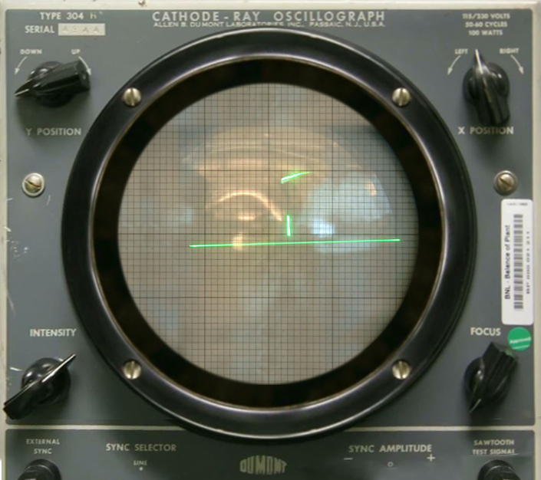

Tennis for Two
Notes:
Tennis for Two, appearing in 1958, was the first video game programmed purely for entertainment.

Slide 4
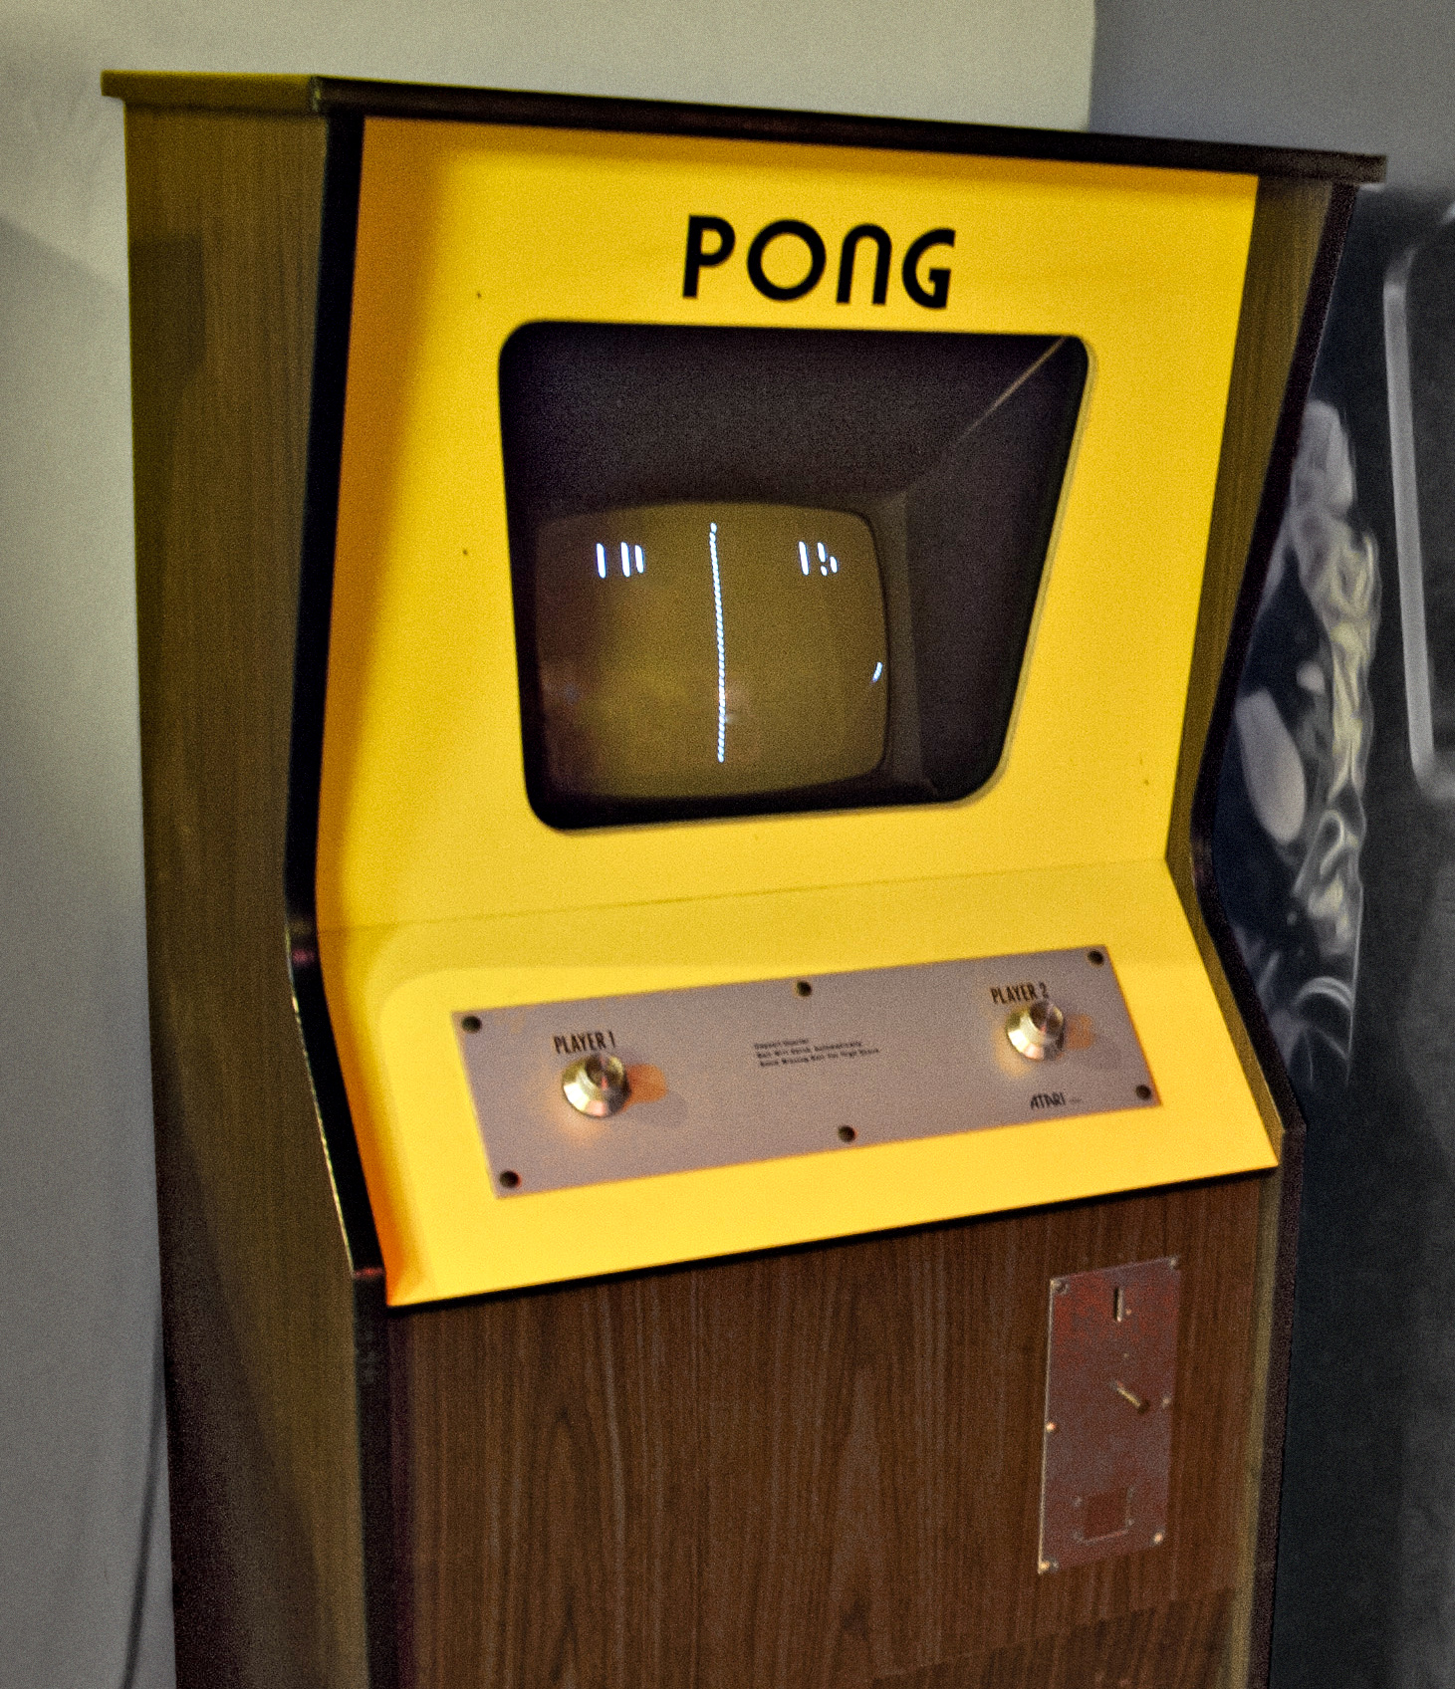

Atari Pong (1958)
Notes:
12 years later, Atari developed Pong, the first game to become a global success. Although the idea for the game was not new, Atari integrated the computer, together with a display screen, into a box with a coin slot – thus inventing the video game machine. For the first time, a video game was available to a broader public for very little money.

Slide 5
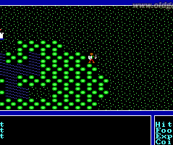
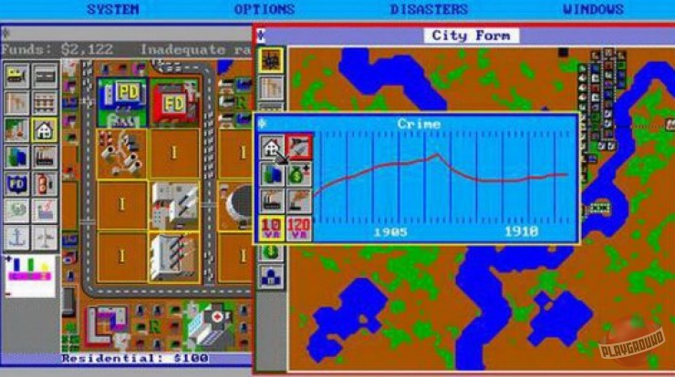
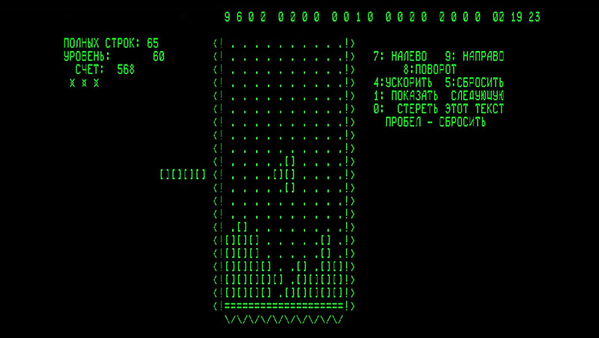
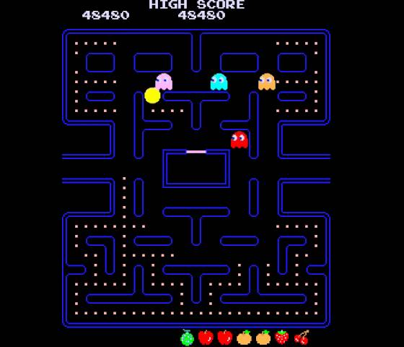
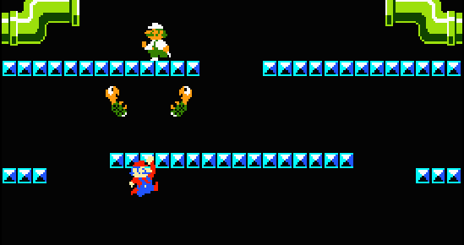
1980s
Gameplay
Graphics
Characters
Stories
Notes:
At the beginning of the 1980s increasingly cheaper and more powerful home computers started appearing. With the more refined technologies, the games pushed forward into new spheres. As the result, gameplay and graphics became more innovative, games got their own characters and more complex stories.

Slide 6

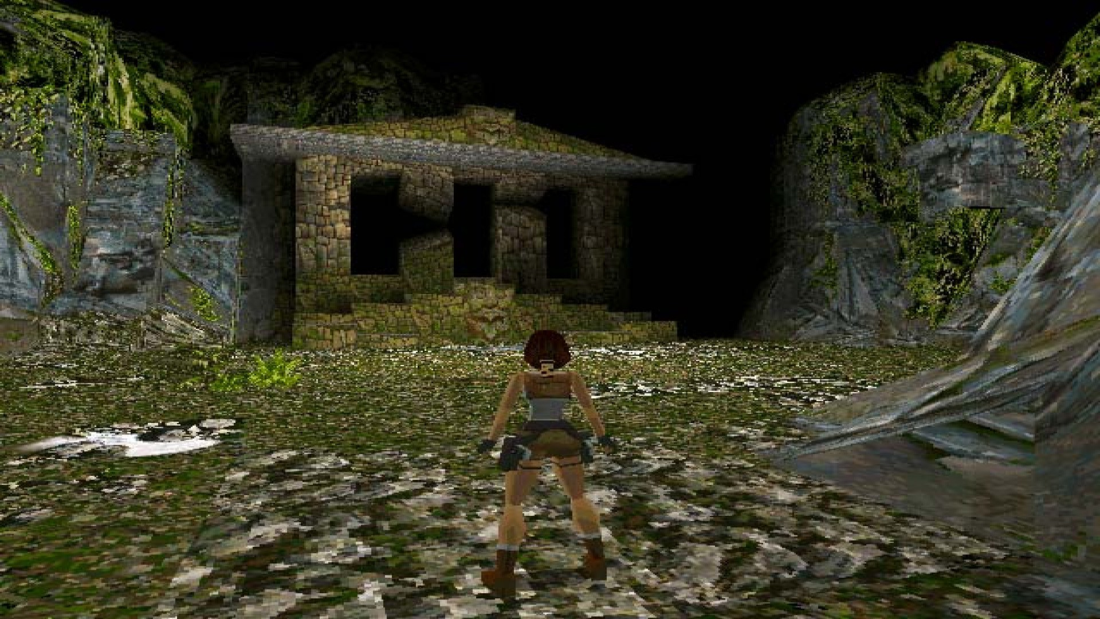
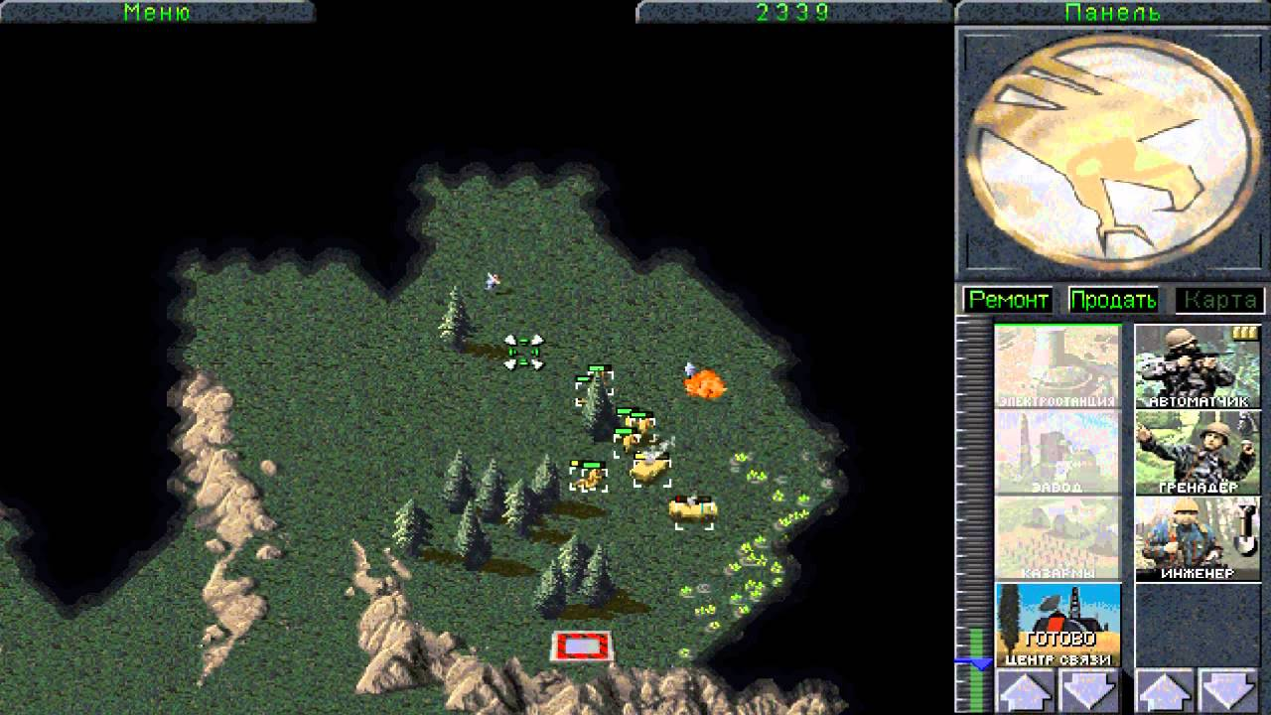
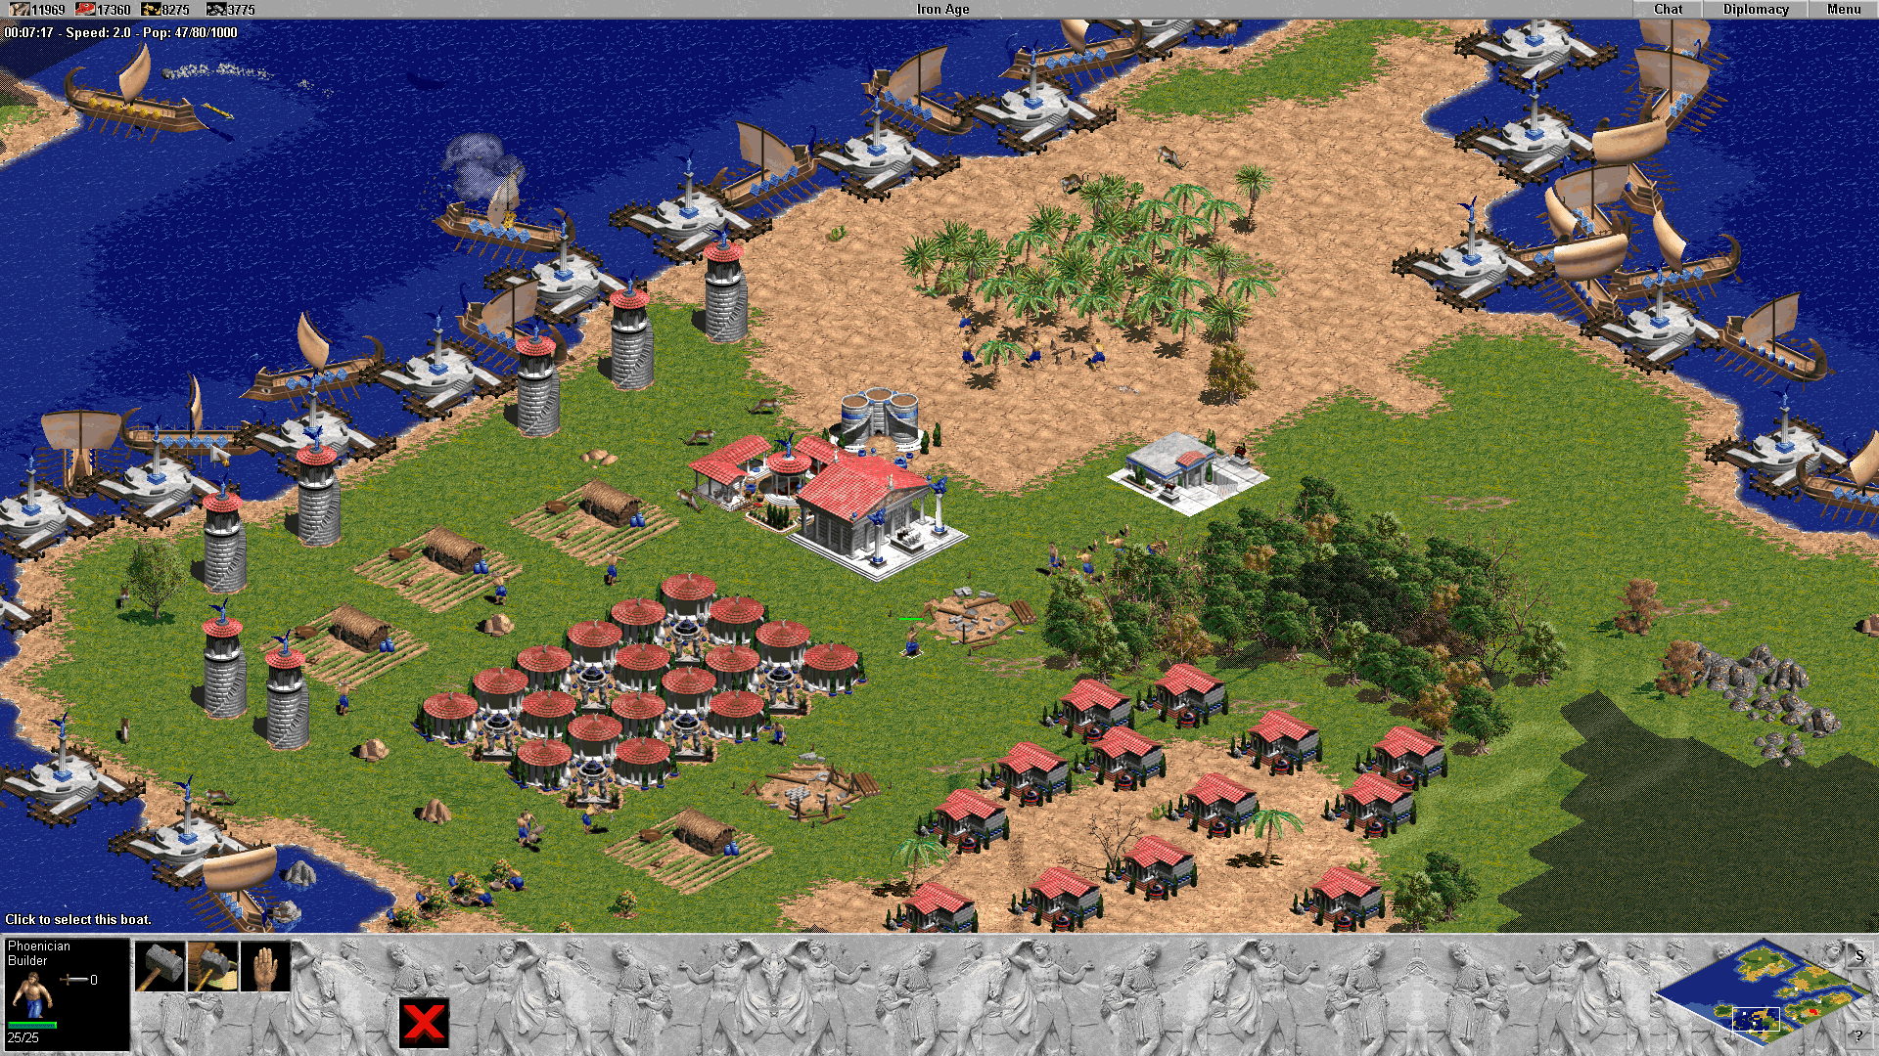

1990s – 3D
Notes:
In 1990s video games entered a new dimension – literally, because in the second half of the decade the graphics became three-dimensional. Thus, game worlds looked more realistic and offered more complex possibilities. But at that time the games industry also lost its innocence because violence increasingly became a theme. For the first time, society starting asking itself whether violence in video games leads to violence in real life.

Slide 7
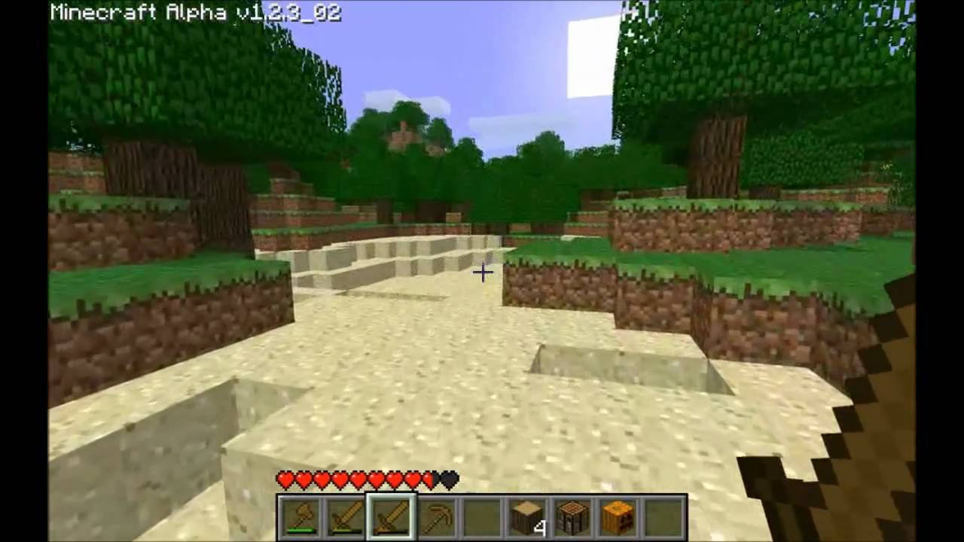


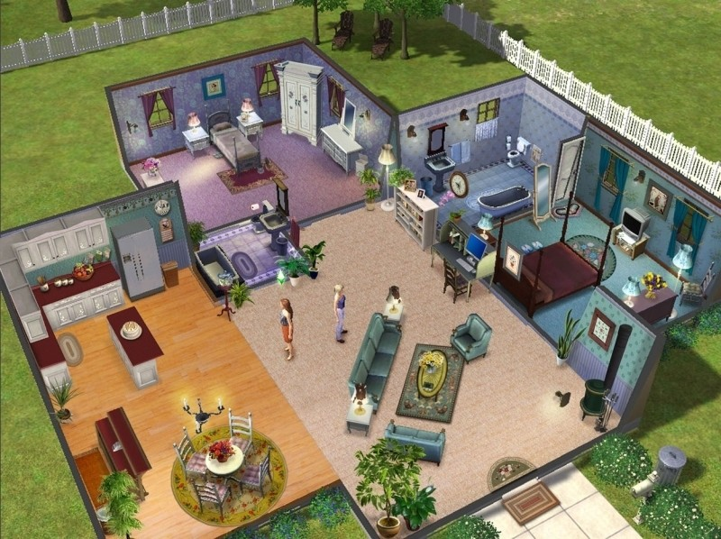
2000s Online and Open-world
Notes:
However, this didn't stop the industry and the beginning of the millennium brought online and open-world games to humanity, in which players independently explore fictional worlds. Many bestsellers were released at that time, such as The Sims, GTA, Super Mario Galaxy and also Minecraft.

Slide 8



2010s
Different types of consoles
High quality graphics
Hyper-realistic 3D landscapes
Notes:
In the decade just ended, video games have become a billion-dollar business. Countless independent game studios have developed games for every type of platform. As a result, even more people are playing video games regularly.

Slide 9
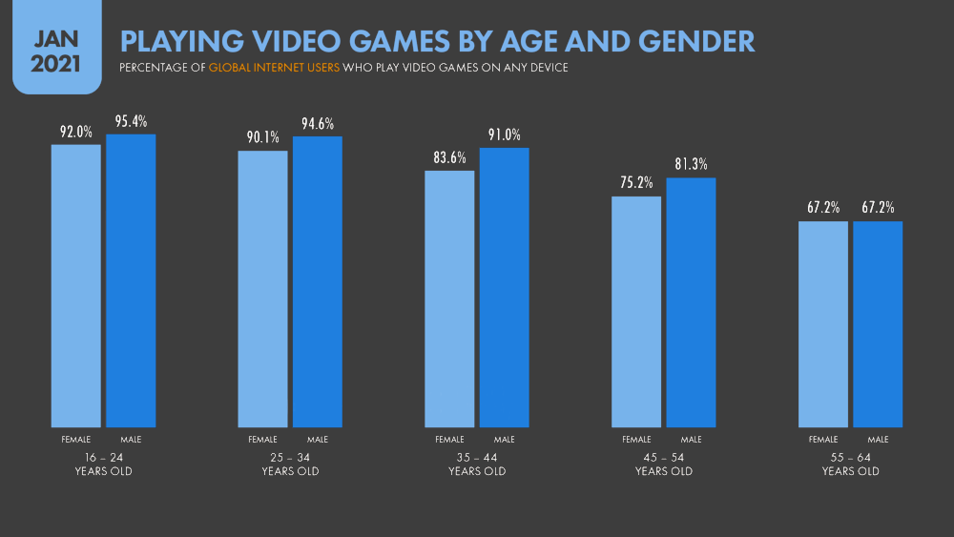
Notes:
Gone are the days when only kids and teens played these games, nowadays older people are also discovering puzzles and skill games on their mobile phones.

Slide 10



Conclusion
Notes:
In conclusion it remains to note how much progress has been made. The industry has evolved from simple dots on a pale color screen to colored pixels and hyper-realistic 3D landscapes. There remains one question. What will the video games of the future look like? One thing is certain: the story will continue in the same style.

